Slide 1
Media queries
Gabriel Mina

Slide 2
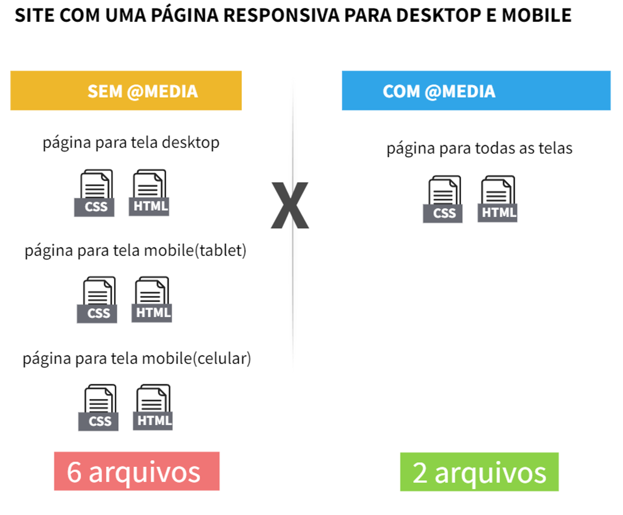

Slide 3
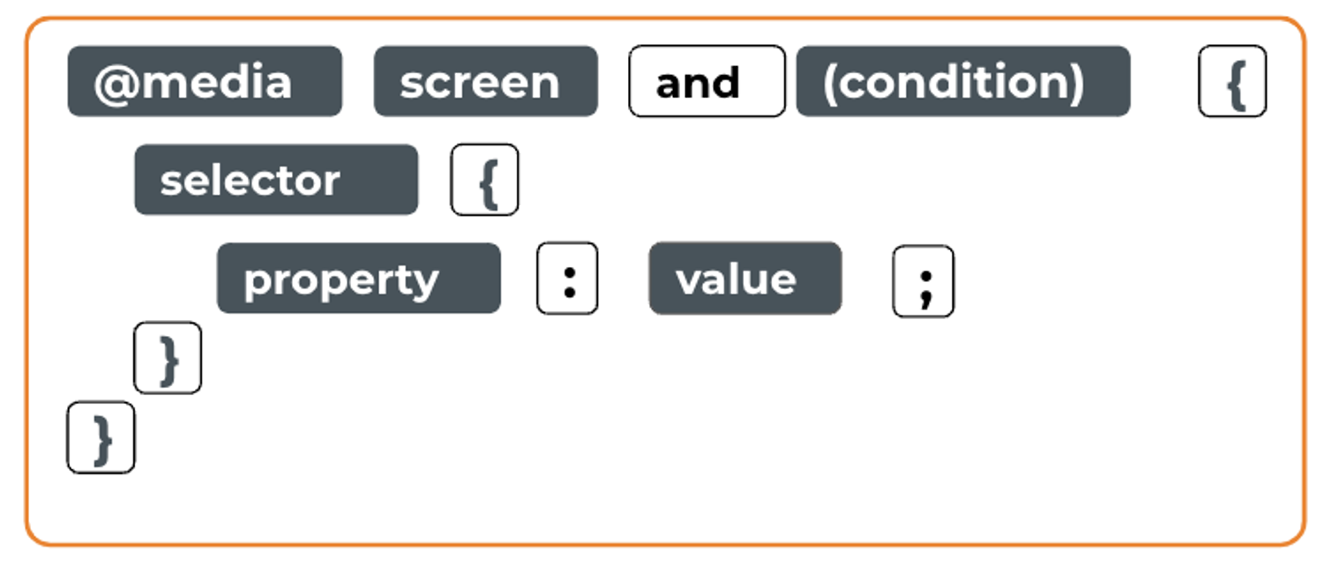

Slide 4
